Slide 1
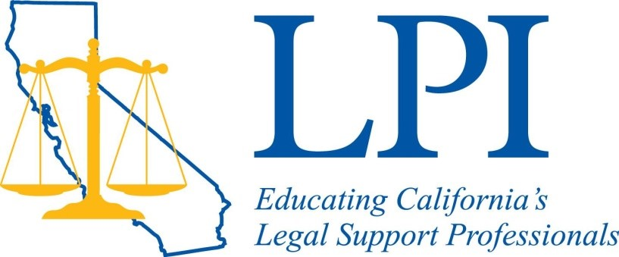
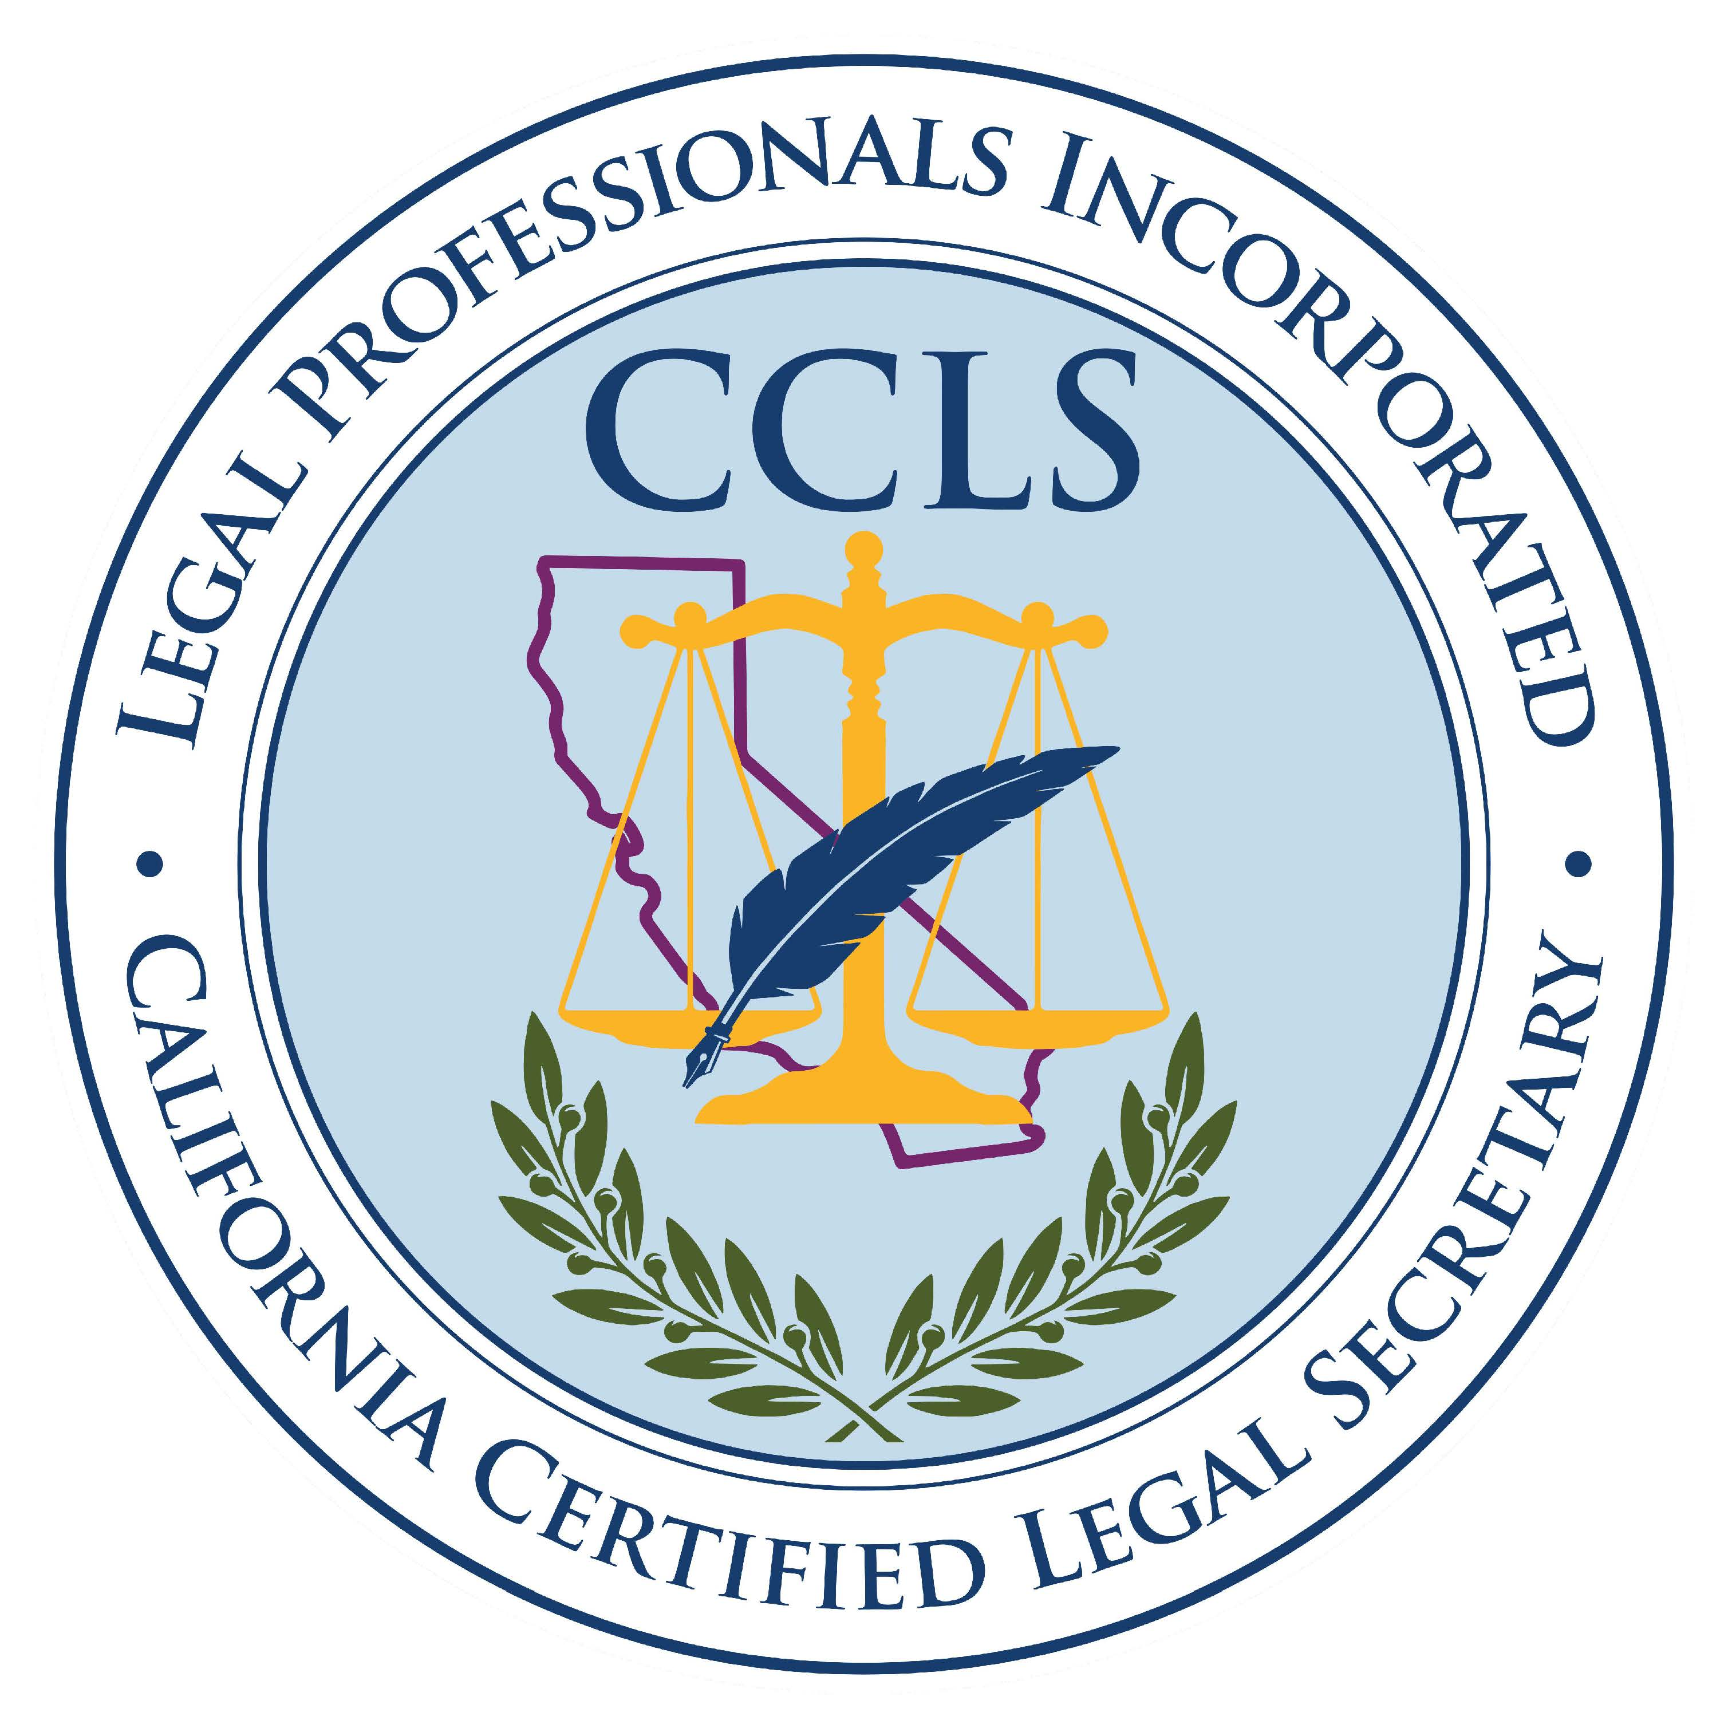
California Certified
Legal Secretary
Legal Professionals, Incorporated

Slide 2

What is the California Certified Legal Secretary?
The California Certified Legal Secretary (“CCLS”) is a program sponsored by Legal Professionals, Incorporated, which tests qualified legal support staff in various areas of law, ethics, practical work product, and office administration. The program is administered by the California Certified Legal Secretary Certifying Board.
To attain their certification, the examinees must pass a rigorous and detailed 8-hour exam, offered twice a year.
Every three years, continuing legal education requirements must be met to maintain certification.

Slide 3

Who Is Eligible to Take the
CCLS Exam?
Any person who has a minimum of 2 years’ full-time experience as a legal secretary, or equivalent as approved by the Certifying Board, may apply to take the exam. Membership in Legal Professionals, Incorporated is not a requirement to take the exam.

Slide 4

What is covered in the
CCLS Exam?
California Legal Procedure
Legal Terminology
Legal Computations
Skills
Ability to Communicate Effectively
Reasoning and Ethics
Law Office Administration

Slide 5

California Legal Procedure
California Legal Procedure covers six areas of law:
Civil Litigation
Probate/Estate Planning
Family Law
Corporations
Real Estate
Federal Civil Procedure (coming soon)
For this section, examinees will need to study the Law Office Procedures Manual. The secondary source of information is taken from the Legal Professional’s Handbook.

Slide 6
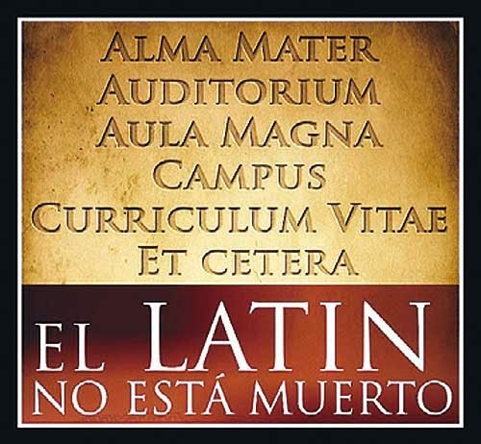
Legal Terminology
Legal Terminology covers proper format of citations and abbreviations, as well as terminology from the six areas of law covered in California Legal Procedure.
For this section, examinees will need to study the California Style Manual and Law Office Procedures Manual.

Slide 7

Legal Computations
Legal Computations covers several types of computations performed every day by legal support staff:
Practical calendaring of due dates and hearings
Ability to determine appropriate filing fees in various areas of law
Basic math calculations done in everyday practice
For this section, examinees will need to study the Law Office Procedures Manual. Examinees may also choose to study a primer on basic math.

Slide 8


Skills
Skills is an exercise in which the examinee is given an instructional memo and a form. Based on the question, the examinee must answer from a list of multiple choices the correct information to fill in a specific part of the form. This section is designed to test an examinee’s ability to follow directions and to proofread.
For this section, examinees will need to study the Law Office Procedures Manual.

Slide 9

Ability to Communicate Effectively
The Ability to Communicate Effectively section of the CCLS exam is designed to test an examinee’s ability to use correct punctuation, grammar, spelling, and word usage.
For this section of the exam, examinees will need to study The Redbook: A Manual on Legal Style (4th ed. or later).

Slide 10

Reasoning and Ethics
Reasoning verifies an examinee’s ability to evaluate facts and situations logically and to reach rational conclusions. Ethics tests their understanding of accepted professional standards of conduct, including accounts management in a law office and notary public issues.
For this section of the exam, examinees will need to study the Pocket Guide to Legal Ethics, California Business and Professions Code (Chapter 4), California Code of Civil Procedure (Part 4), California Rules of Professional Conduct (Chapters 1-5), and the California Notary Public Handbook.

Slide 11

Law Office Administration
Law Office Administration covers the following areas:
Alphabetic filing
Computer use and terminology
Notary Public practices
General office procedures
For this section of the exam, examinees will need to study The Redbook: A Manual on Legal Style, Computers Made Easy: From Dummy to Geek, Law Office Procedures Manual, the Pocket Guide to Legal Ethics, and the California Notary Public Handbook.

Slide 12

Grading and Passing the Exam
The CCLS exam is a multiple-choice and/or true/false exam. The test is given via Zoom using ClassMarker software. Following an extensive review process by the California Certified Legal Secretary Certifying Board, results are finalized and sent to the examinees. There are two ways to pass the exam:
1. Attain a score of at least 70% on each section of the Exam, or
2. Attain an overall score of at least 75% when averaging the scores on each section of the Exam

Slide 13

Partial and Full
Re-Takes
If an examinee passes at least 4 sections of the exam with a score of 70% or better, that examinee only needs to re-take those sections which were not passed. The examinee will need to pass the remaining sections with a score of at least 70% on each section.
Examinees must pass the full exam within the next 6 consecutive regularly scheduled exam dates from passing the minimum 4 sections.
If an examinee does not pass at least 4 sections, they will need to re-take the entire exam.

Slide 14

Exam Review
When an examinee does not pass the entire exam, they may review just those sections of the exam that they did not pass with a score of 70% or better.
Examinees must request an exam review within 20 days of receipt of their exam results, using the form provided with their results.
Examinees will have 90 minutes to review the exam but may have more time at the discretion of the Certifying Board.

Slide 15


After Passing the Exam
After passing the CCLS exam, CCLSs must recertify every three years. In order to recertify, a CCLS must complete 15 hours of continuing education, as follows:
A minimum of 15 credit hours of approved education. Of that 15 hours, no more than 5 hours may be self-study
Of that 15 hours, a maximum of 6 hours may be regarding administrative and/or mechanical functions performed by legal support staff
Of those 6 hours, no more than 2 hours shall be allowed for educational courses where topics are not unique to work done by legal support staff (e.g., notary class)

Slide 16

Study Options
There are various options for studying for the exam:
Join a local association study group – you can contact your local association or the LPI CCLS Chair to find out if a group is offered in your area.
Join the LPI Online Study Group – if no local group is offered or the class schedule doesn’t meet your schedule, you can join the LPI CCLS Online Study Group. Information can be found on the LPI website.
Study on your own – If you prefer to study on your own, the CCLS Study Kit available on LPI’s website will provide you with information and guidance for studying on your own.
Study with a buddy - this can be done in person, or via telephone or online meeting.
This Photo by Unknown Author is licensed under CC BY-SA-NC

Slide 17

Benefits to the Employer
A well-rounded employee who has knowledge of several areas of law – your employee will have enough knowledge in various areas of law that will allow him or her to jump in and assist on cases that may not be in the firm’s usual practice area.
A professional employee – a CCLS must maintain continuing education credits and pass a rigorous exam in order to maintain their certification.
A quick reference – a CCLS will have a wealth of knowledge ready to answer questions and assist others, or if he or she does not know the answer, they know where and how to find it quickly.

Slide 18

Benefits to the Employer (Cont.)
A self-confident employee – a CCLS has passed a very difficult and thorough exam. Passing the exam increases their self-confidence, which improves efficiency and boosts their morale.
A pre-screened potential employee – when hiring employees, if they are a CCLS, you will know that they already have knowledge in many areas of law, and that they have passed an exam that thoroughly tests them on that knowledge.

Slide 19

Benefits to the Employee
Self-confidence – this is a rigorous exam, and passing it is quite an accomplishment.
Knowledge – gaining knowledge in several areas of law will make you a more valuable employee; you will be able to jump in and assist with those odd cases that come in that may not be in the firm’s usual practice areas.
Recognition as a professional – you will gain recognition among employers and your peers for being a professional, required to pass a rigorous exam and obtain continuing education.
Marketability – as a CCLS, you will have already demonstrated to a potential employer that you have knowledge in many areas of law and have passed an exam that thoroughly tests you on that knowledge.

Slide 20
Excerpt of Testimonial of
Vivian Shreve, CCLS
Santa Clara County LPA
“. . .To sum it all up, the CCLS exam was by far the hardest thing I’ve ever had to study for. I often tell people it is the hardest exam a non-attorney professional will ever have to take. It is like studying for the LSATs or the Bar exam. But passing it has made it all worth it. My confidence level has skyrocketed. The respect that I get from my employer and co-workers has been amazing. And the opportunities that it has opened up for me have been incredible. And I’ve gotten more job offers than I can count. In this day and age, knowing that you are a little more marketable goes a long way. I’m not worried about my job here right now, but I’ve survived several rounds of layoffs. Having the CCLS helps me to know that if something should happen and I lose my job here, I know that I can go elsewhere and have no problem finding another job. CCLS looks great on your résumé.”
Apply today!

Slide 21
CCLS Certification: An Attorney’s Perspective
When I got my first job with a law firm, even before I passed the Bar Exam, I was repeatedly told to listen to and learn from my legal secretary because they knew more about the practice of law than I did. Having had the added benefit of being married to a legal secretary at the time (who worked at the same firm), I knew it was true. And if I ever forgot, my wife would remind me. However, I also pretty quickly discovered that the skills, quality, training and experience of the various legal secretaries that I would come to work with in my career varied dramatically. I worked with a number of secretaries who had been in the profession for many years, but who lacked the confidence, skills, knowledge and resources to be effective team members – in many ways making my job harder rather than easier.
When we formed Messing Adam & Jasmine several years ago, we brought with us from our previous firm three secretaries for our Sacramento office (Lynne Prescott, Heather Rodriguez, and Lacy Monserrat), two of whom had already achieved the CCLS designation, and one who had been working toward it and achieved the designation shortly after we formed the firm. Now closing in on my 20th year of practice, I can comfortably say that our CCLS-certified staff is the best team of legal secretaries I have ever worked with, and there are several things that reflect this:

Slide 22
(Cont’d)
The overall quality of their work is higher.
They have a level of confidence and willingness to question (appropriately) attorneys they are working with in order to make sure everything is being done correctly.
I rarely have to deal with significant mistakes, and when the inevitable mistake does happen, I’m presented with solutions and fixes.
The CCLS network is also a great resource that our legal secretaries can draw from when a particularly complicated issue arises.
Of course, people work for a paycheck. But for many people, it seems like they couldn’t care less what they were doing to earn that paycheck. The CCLS-certified secretaries I have the pleasure of working with on a daily basis are truly part of the team, are professional, responsible, and truly care about the work they are doing.
By Jason Jasmine, Esq.

Slide 23
For additional information:
Legal Professionals Incorporated website – www.legalprofessionalsinc.org
LPI California Certified Legal Secretary chair – cclschair@legalprofessionalsinc.org
California Certified Legal Secretary Certifying Board – certifyingboard@legalprofessionalsinc.org or send inquiry through LPI’s website
Local associations – see list located on LPI’s website
(Rev. 5-1-26)

